Slide 1
Quo vadis caementum – nothing goes without rheology
Dr.-Ing. D. Hornung, Dyckerhoff AG Wiesbaden, Portfoliomanagement & Anwendungsberatung
Kolloquium Rheologische Messungen an mineralischen Baustoffen, Regensburg 29.02.2012

Slide 2
Content
Sustainability – Modern trends or duty of enterprise strategy?
Cement production and CO₂ emission – CEM II and CEM III become standard
M-cements – optimised for performance, durable and uniform
Rheology of cement paste vs. cement standard parameters
Rheology of cement paste – Experience from 5 years RheoZ
Summary

Slide 3
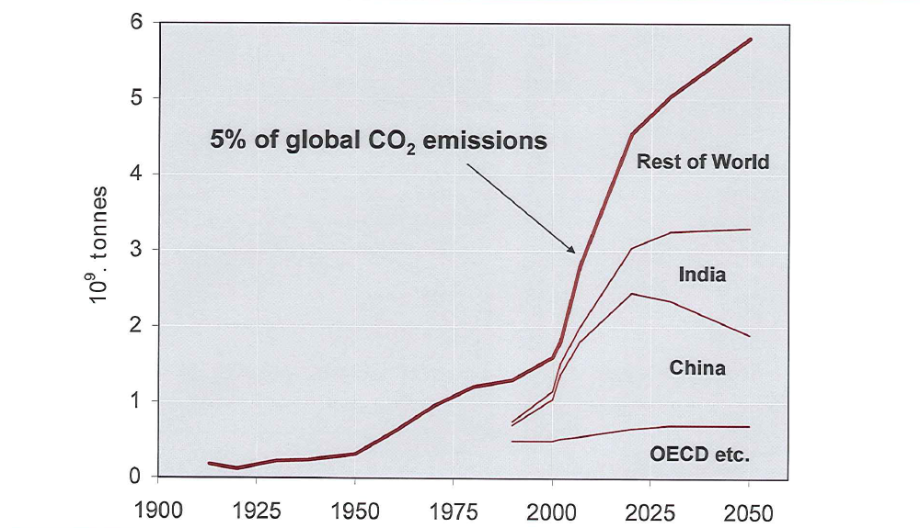
CO₂ Ranking industry
CO2-Emission
Cement industry

Slide 4



Cement Technology
Roadmap 2009
No alternative clinker concepts !

Slide 5
Content
Sustainability – Modern trends or duty of enterprise strategy?
Cement production and CO₂ emission – CEM II and CEM III become standard
M-cements – optimised for performance, durability and uniformity
Rheology of cement paste vs. cement standard parameters
Rheology of cement paste – Experience from 5 years RheoZ
Summary

Slide 6
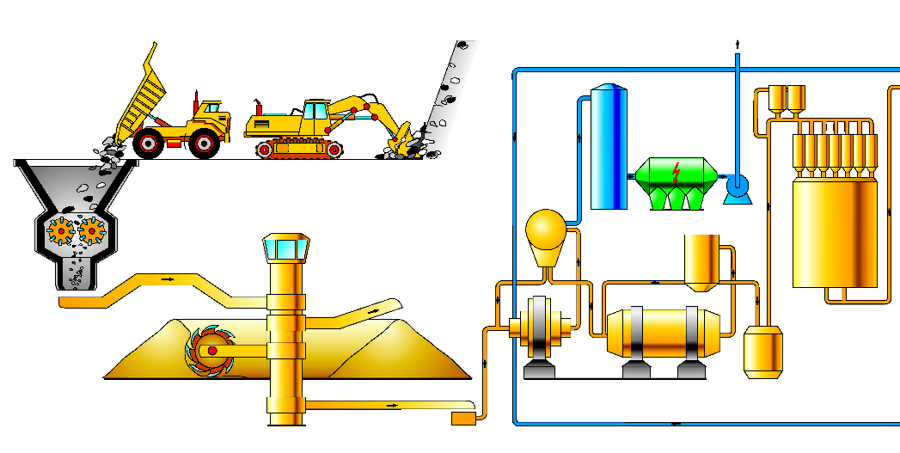
Raw material for cement production
Raw material quarrying
Raw material preparation
CaCO₃

Slide 7
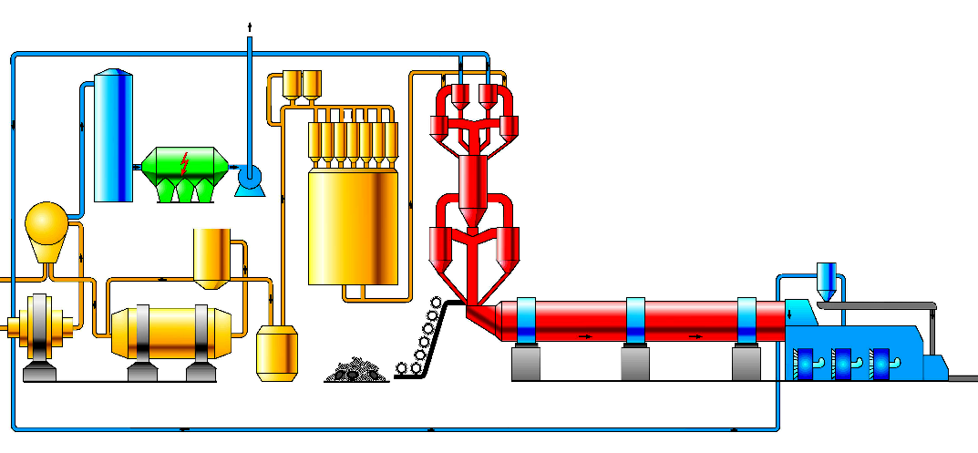
Preparation and sintering
Raw material preparation
Clinker sintering
Emission von 0,85 t CO₂/ t Klinker
Prozessbed. / „Entsäuerungs“ - CO₂:
CaCO₃  CaO + CO₂
0,525 t CO₂ pro t Klinker
Brennstoffbed. CO₂
0,32 t CO₂ pro t Klinker
1450°C
Klinker

Slide 8
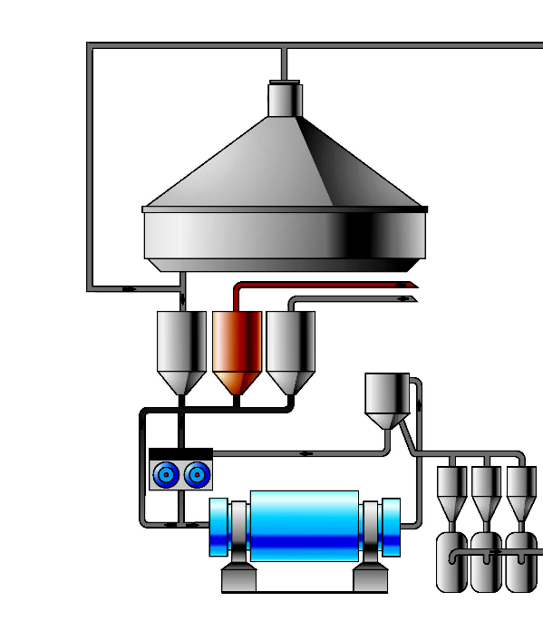
Cement grinding
Clinker
Clinker storage
„CO₂-free“
Gypsum
Limestone LL
CEM I
CEM II CEM III
CEM IV CEM V
BFS S
Pit coal FA V
Trass P
Cement mill

Slide 9
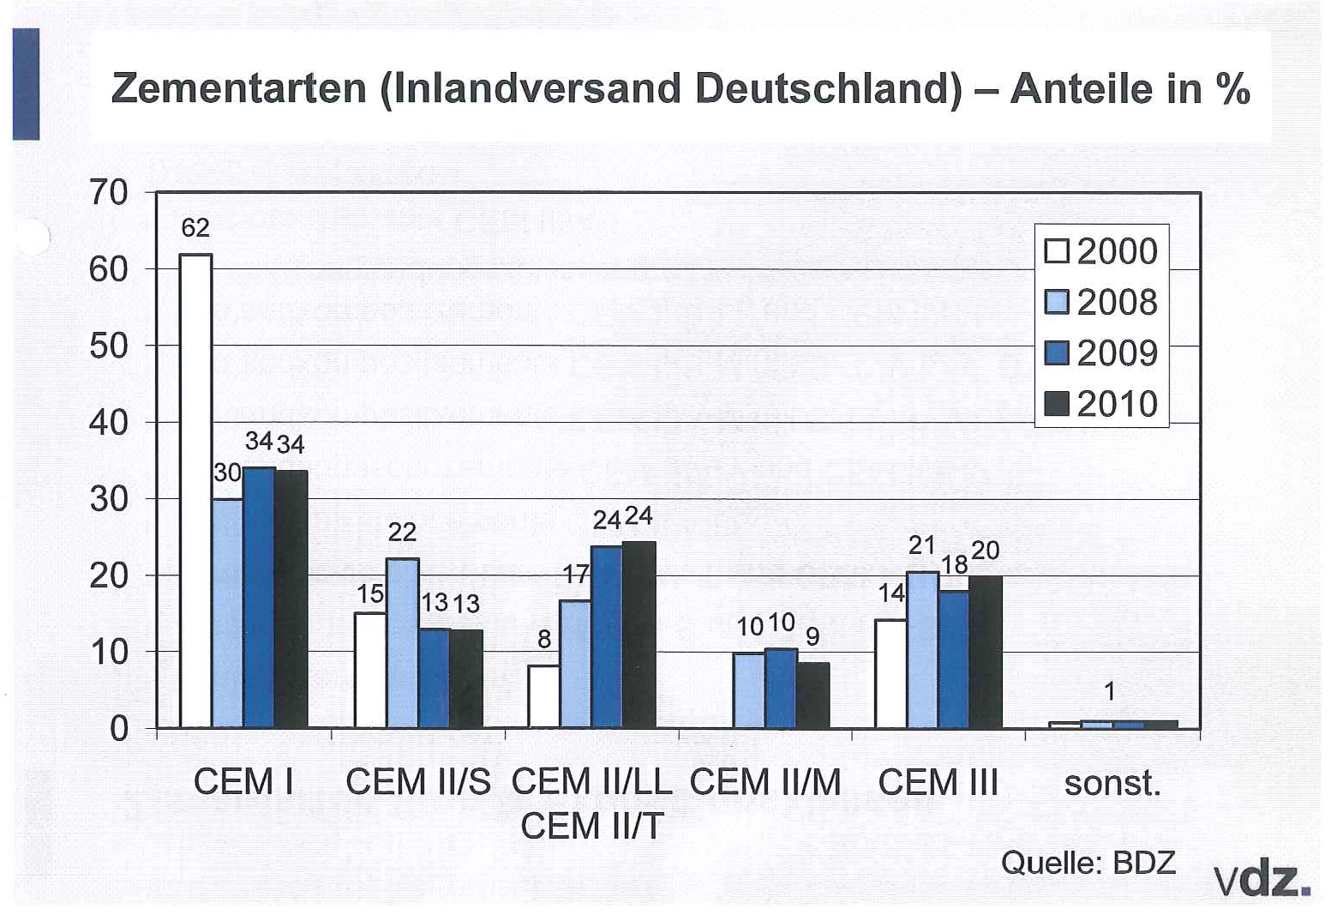
CEM II = Standard cements in Germany
CEM II ~ 50%

Slide 10
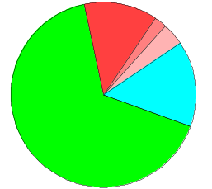
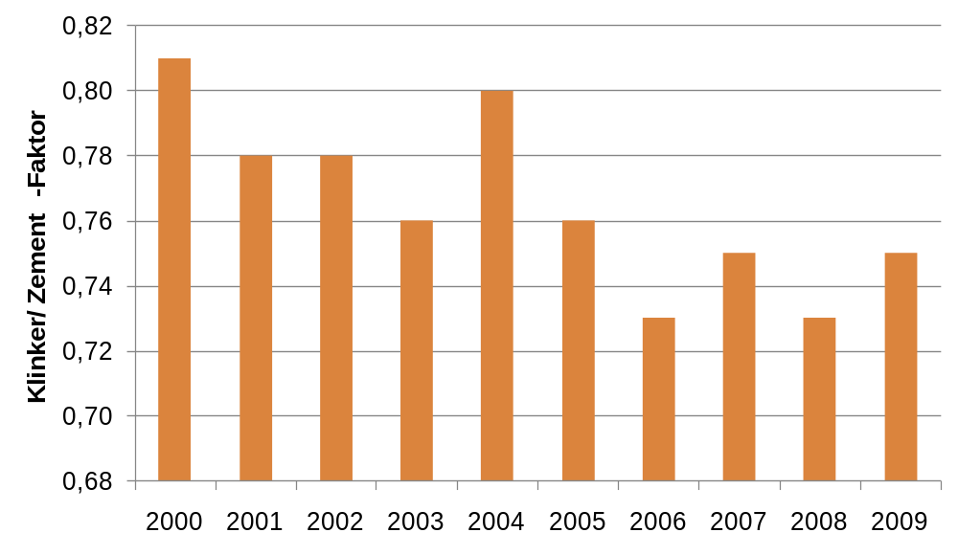

Clinker rate – Cements Germany vs. Dyckerhoff
CEM II 19 %
CEM II/B-M
Dyckerhoff
CEM III 15 %
CEM I 66 %
80,6%
Clinker rate Dyckerhoff
75,3%
73,9%
73,8%
71,6%
Dyckerhoff
CEM II 42 %
CEM III 25 %
70,2%
CEM II/B-M
CEM I 33 %
2010

Slide 11
CEM II = Composite cements
CEM II / CEM III = CEM I + other materials with hydraulic properties
S Blast-furnace slag (finely ground, granulated blast-furnace slag)
V Pit coal fly ash (finely ground/not ground/separated)
LL Limestone (finely ground, increased requirements)
P Trass (finely ground)
Long-time experience with S, V, LL, P in cement/concrete
Expanded normative requirements for cement/concrete
Increased R & D for composites in cement/concrete
Good durability properties

Slide 12
Reaction of C₃S + finely ground limestone
Influence of limestone on hydration
12
11
without FM/KSM
10
15% KSM
9
35% KSM
8
0,40% FM
0,40% FM/15% KSM
7
Rate of heat development [J/gh]
0,40% FM/35% KSM
6
5
4
3
2
0
6
12
18
24
30
36
Time of hydration [h]

Slide 13
Reaction of C₃S + finely ground limestone
Increased C-S-H phase development
Dense C-S-H phase formation
at C₃S and limestone surface
Limestone base
ESEM image without and with ground limestone

Slide 14
Content
Sustainability – Modern trends or duty of enterprise strategy?
Cement production and CO₂ emission – CEM II and CEM III become standard
M-cements – optimised for performance, durability and uniformity
Rheology of cement paste vs. cement standard parameters
Rheology of cement paste – Experience from 5 years RheoZ
Summary

Slide 15
CEM II in cement standard EN 197
Zement | PZ – Klinker Minimum | Hüttensand S Maximum | KalksteinLL Maximum | SFA V Maximum | Trass P Maximum
CEM I | 95 | - | - | - | -
CEM II/A-S | 80 | 20 | - | - | -
CEM II/B-S | 65 | 35 | - | - | -
CEM II/A-LL | 80 | - | 20 | - | -
CEM II/B-LL | 65 | - | 35 | - | -
CEM II/A-V | 80 | - | - | 20 | -
CEM II/B-V | 65 | - | - | 35 | -
CEM II/A-M (S-LL) | 80 | 20 (S + LL) |  | - | -
CEM II/B-M (S-LL) | 65 | 35 (S + LL) |  | - | -
CEM II/A-M (V-LL) | 80 | - | 20 (V + LL) |  | -
CEM II/B-M (V-LL) | 65 | - | 35 (V + LL) |  | -
CEM II/B-P | 65 | - | - | - | 35
CEM III/A, CEM III/B, CEM III/C, CEM IV, CEM V

Slide 16
Cement grinding common milling
Clinker
Clinker storage
„CO₂ free“
Gypsum
Limestone LL
CEM I
CEM II CEM III
CEM IV CEM V
BFS S
Pit coal FA V
Trass P
Cement mill

Slide 17
Cement grinding separate milling/mixing
Clinker
Clinker storage
Separate grinding
Ground limestone LL
Ground BFS S
Pit coal FA V
Gypsum
Ground trass P
CEM I
CEM II CEM III
CEM IV CEM V
Cement mill

Slide 18
Cement grinding
common milling vs. separate milling/mixing
Advances separate milling/mixíng
Finenesses of components can be adjusted individually
Optimisation of grain size distribution of mixed cements
Optimisation of packing density/water demand/workability
Optimisation of hardening reactions
Improvement of durability
Custom-tailored cements
Dyckerhoff CEM II/B-M(S-LL) 32,5 R / 42,5 R / 52,5 R (MZ-S)
Dyckerhoff CEM II/B-M(V-LL) 32,5 R (MZ-V)

Slide 19
Optimised combination of LL and S/V
Characteristic LL components
-Acceleration early strength development, heat development
-decreased late strength development
-Inert on durability properties (< 30% ?)
+
Characteristic S, V components
-Decelerated setting/hardening and heat development
-increased late strength development
-Improved durability properties (Pore microstructure and intrusion resistance)

Slide 20
Optimised combination of LL and S/V
Characteristic LL components
-Acceleration early strength development, heat development
-decreased late strength development
-Inert on durability properties (< 30% ?)
+
Characteristic S, V components
-Decelerated setting/hardening and heat development
-increased late strength development
-Improved durability properties (Pore microstructure and intrusion resistance)

Slide 21
Optimised combination of LL and S/V
Characteristic LL components
-Acceleration early strength development, heat development
-decreased late strength development
-Inert on durability properties (< 30% ?)
+
Characteristic S, V components
-Decelerated setting/hardening and heat development
-increased late strength development
-Improved durability properties (Pore microstructure and intrusion resistance)

Slide 22
CEM X – Continuation of CEM II/B-M
EN 197-1 Expansion / Bauaufsichtliche Zulassung
Cement | PZ – Clinker Minimum | BFS S Maximum |  | Limestone LL Maximum |  | PFA V Maximum | Trass P Maximum
CEM I | 95 | - |  | - |  | - | -
CEM II/A-S | 80 | 20 |  | - |  | - | -
CEM II/B-S | 65 | 35 |  | - |  | - | -
CEM II/A-LL | 80 | - |  | 20 |  | - | -
CEM II/B-LL | 65 | - |  | 35 |  | - | -
CEM II/A-V | 80 | - |  | - |  | 20 | -
CEM II/B-V | 65 | - |  | - |  | 35 | -
CEM II/A-M (S-LL) | 80 | 20 S + LL |  |  |  | - | -
CEM II/B-M (S-LL) | 65 (40-50) | 35 (60-50) S + LL |  |  |  | - | -
CEM II/A-M (V-LL) | 80 | - | 20 V + LL |  |  |  | -
CEM II/B-M (V-LL) | 65 (40-50) | - | 35 (60-50) V + LL |  |  |  | -
CEM II/B-P | 65 | - | - |  | - |  | 35
CEM III/A, CEM III/B, CEM III/C, CEM IV, CEM V
CEM X
CEM X

Slide 23
Content
Sustainability – Modern trends or duty of enterprise strategy?
Cement production and CO₂ emission – CEM II and CEM III become standard
M-cements – optimised for performance, durability and uniformity
Rheology of cement paste vs. cement standard parameters
Rheology of cement paste – Experience from 5 years RheoZ
Summary

Slide 24
Customer benefit analysis cement
„Welche Nutzenfaktoren sind Ihnen am Zement/Lieferanten besonders wichtig?“
1. Quantitative assessment of benefit criteria:
1. Position Price (30%)
2. Position Product uniformity (13%)
.
. < 10% (Reliability, logistics, references, R & D, consulting, …)
.
„Very high evalution of product uniformity regarding customer benefits“
2. Improvement potentials for customer benefits:
„In all markets (ready-mix, conctruction elements, plaster and mortar) the improvement of product uniformity achieves the strongest positive effects amongst all criteria.“
(Except price reduction)

Slide 25
Product strategy Dyckerhoff = . . . + Product uniformity
Product uniformity cement = Constant
Workability of cements (Cement paste)
Mechanical strength properties of the cements (hardened cement)
Durability of the cements (hardened cement)
Additional properties (Colour, fineness, composition,
rheological properties of dry cement,
heat development, etc.)

Slide 26
Product uniformity
Increasing importance of product uniformity:
automated, fast production processes
increased quality requirements on final products concrete, …
Cost pressure at the cement customer (Minimisation of failures and reserves)
Increased rate of sensitive and softer concretes
Reduction of cement content in concrete
Increased application of concrete chemistry

Slide 27

Produktgleichmäßigkeit Verarbeitungseigenschaften Beton
Workability of concrete:
Rheological properties of fresh concrete between mixing and setting (stiffening, concrete binding, …)
Rheological properties of fresh concrete are strongly dependent on the rheological properties of the fluid phase of the fresh concrete (mortar/cement paste)
Other influences: Concrete composition, mortar content, paste content
additives
temperature
.
.
Rheology/workability cement paste

Slide 28
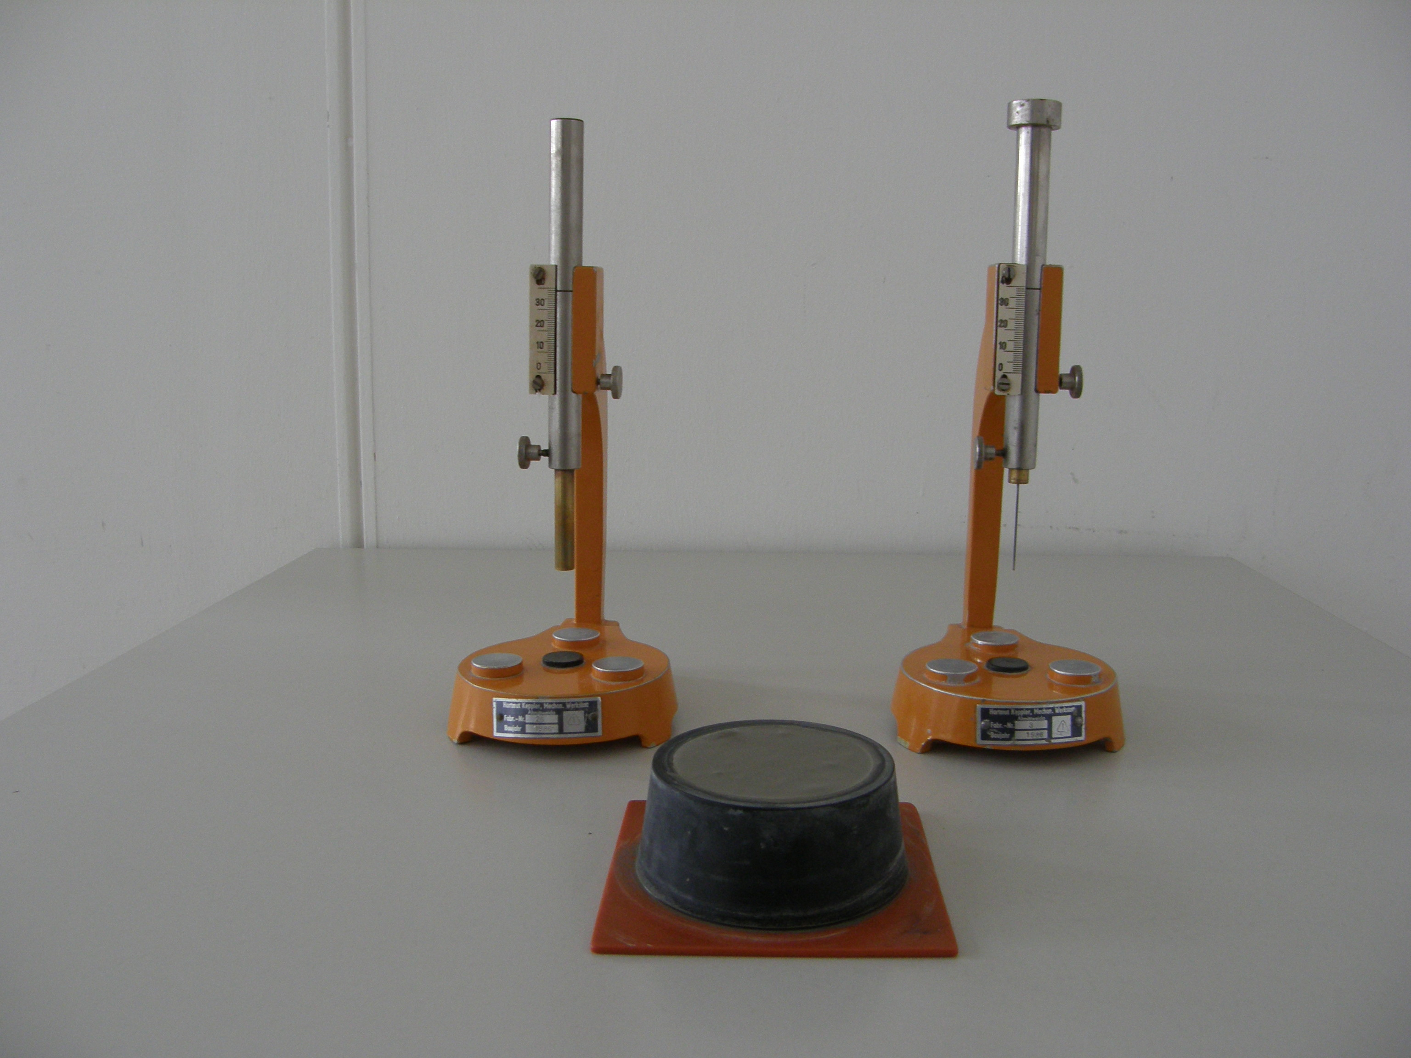
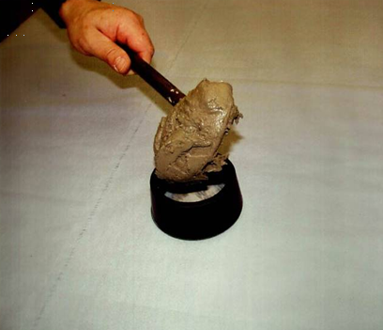
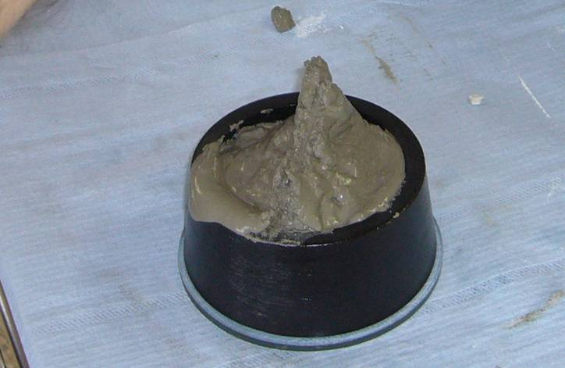
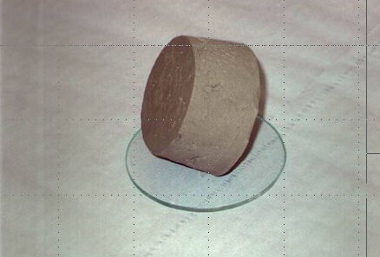
Workability parameters cement acc. DIN EN 196 Teil 3
Water demand, begin of setting
not relevant to practice
w/c 0,25 – 0,35 (without SP, „tamped
concrete“)
- static, insensitive method
- no continuous rheological
information during setting
Standard parameters are not the practical
workability parameters
In the market: Introduction of own methods
General critisism in the market regarding
workabilty

Slide 29
Product uniformity – Workability of cement paste
Product uniformity
=
Uniformity of cement standard parameters
+
Uniformity of additional properties
Duty
+
Volantary

Slide 30
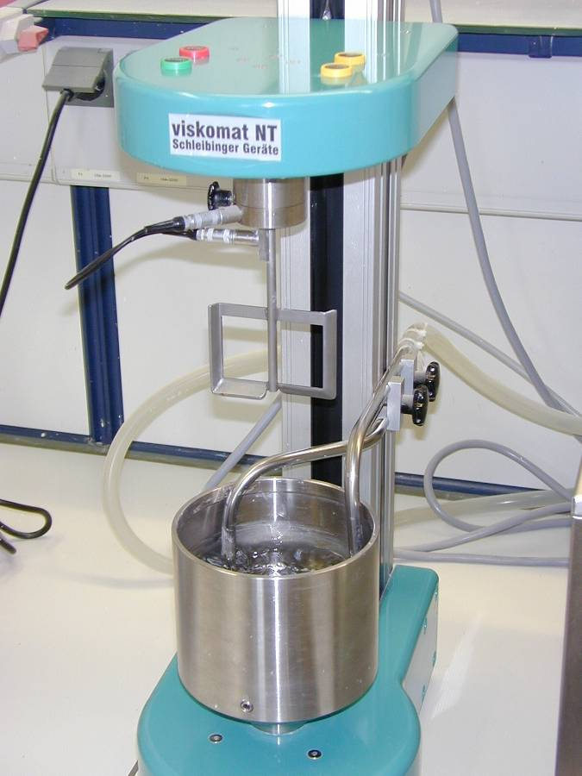
Hydraulic binder rheology with the Viskomat NT
Principal:
Der Viskomat is a universal viscometer for measuring the consistancy/stiffness of fluid binder mixes.
The cement paste rotates in a pot mit with a fixed paddle. The torsional force is measured, depending on the stiffness of the cement paste.

Slide 31
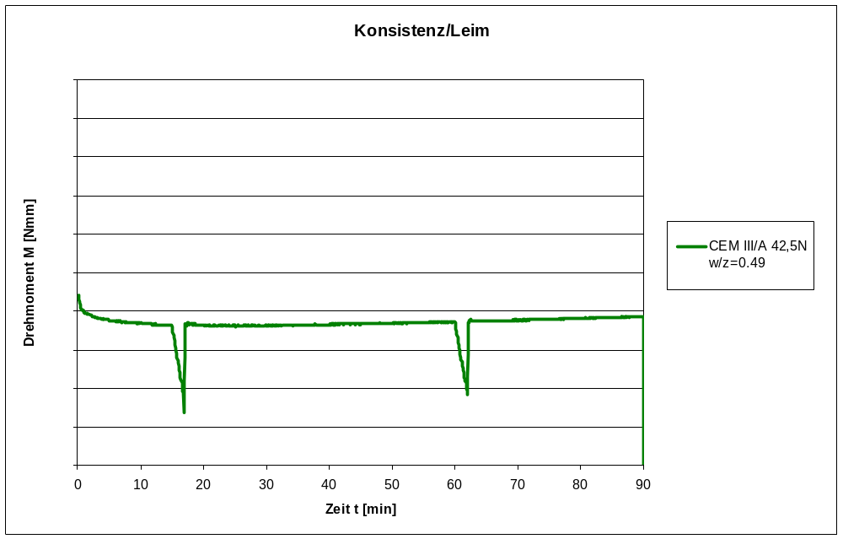
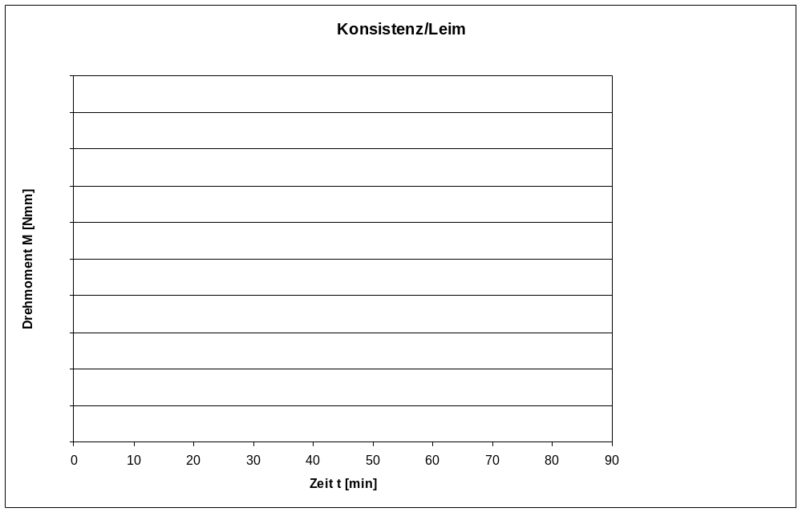
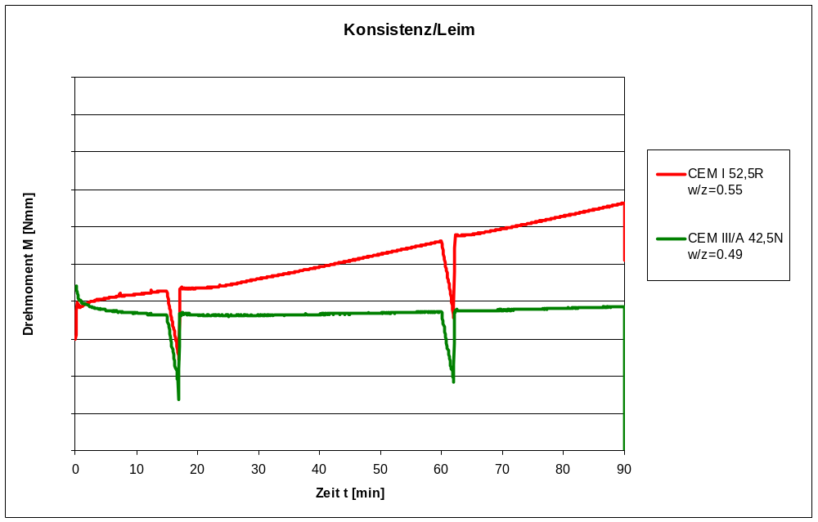
Rheometry cement paste with Viskomat NT
Rücksteifen
Ansteifen
Rücksteifen
Ansteifen

Slide 32
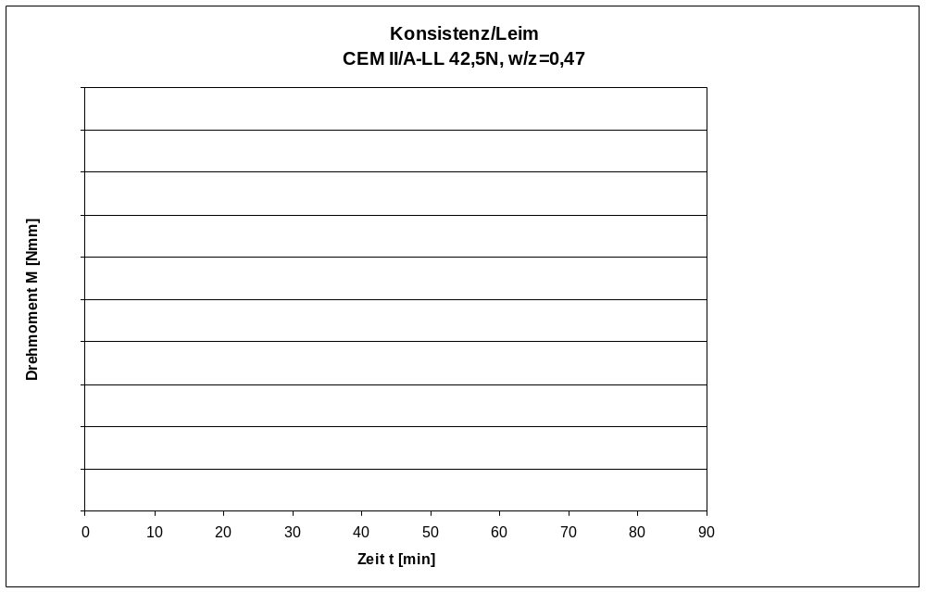
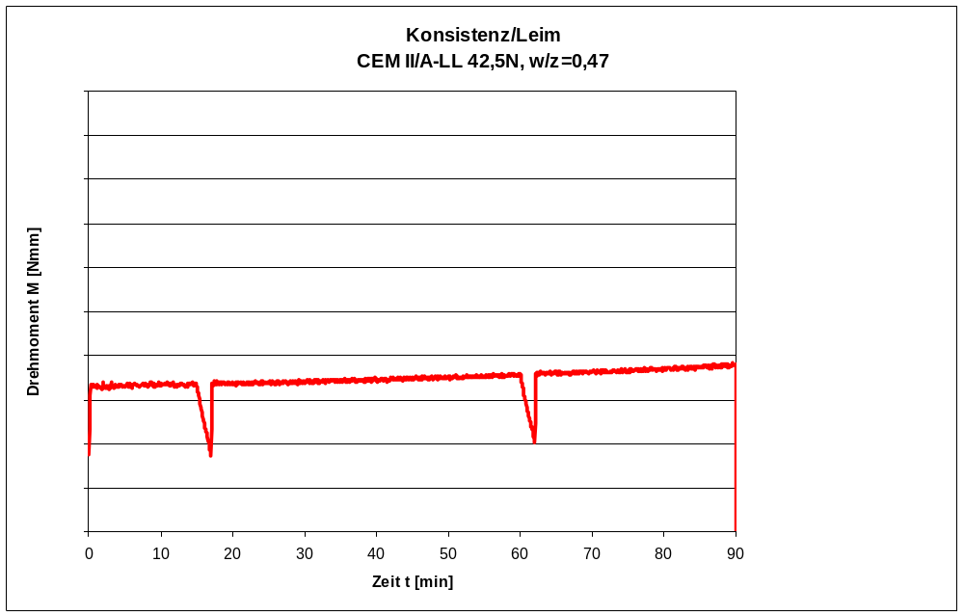
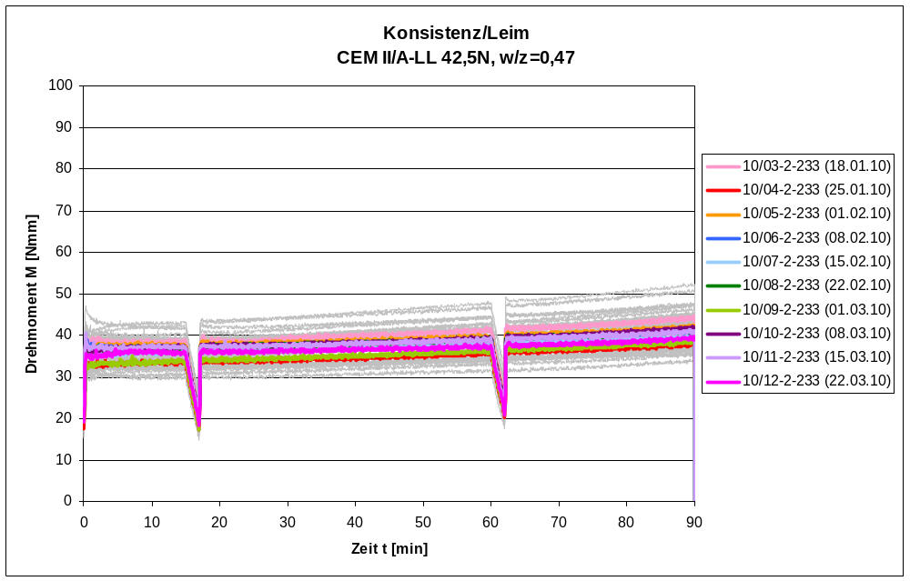
Rheomety in quality control:
Torque M = f (time t)

Slide 33
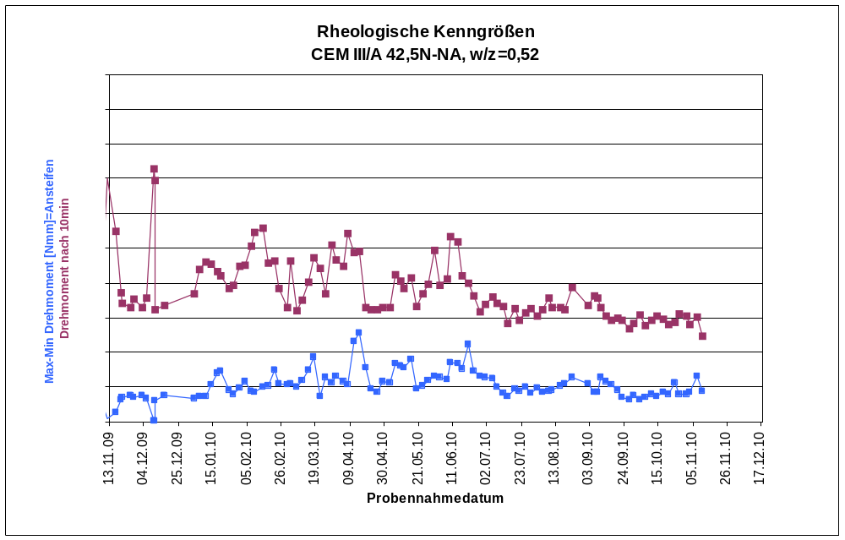
Rheometry in quality control:
Ansteifen/Rücksteifen = f (shipping date)
Ansteifen
Rücksteifen

Slide 34
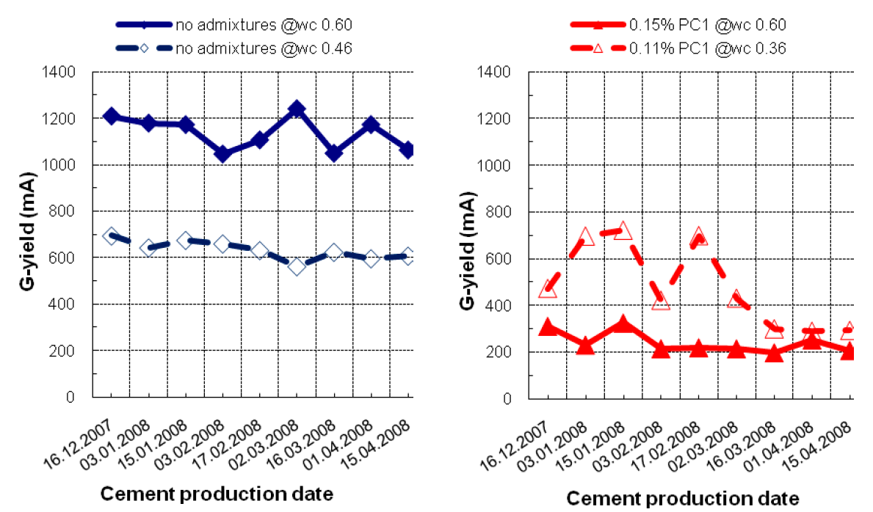
Changing workability
Kubens, Katz, Bentur, Wallevik, 2010

Slide 35
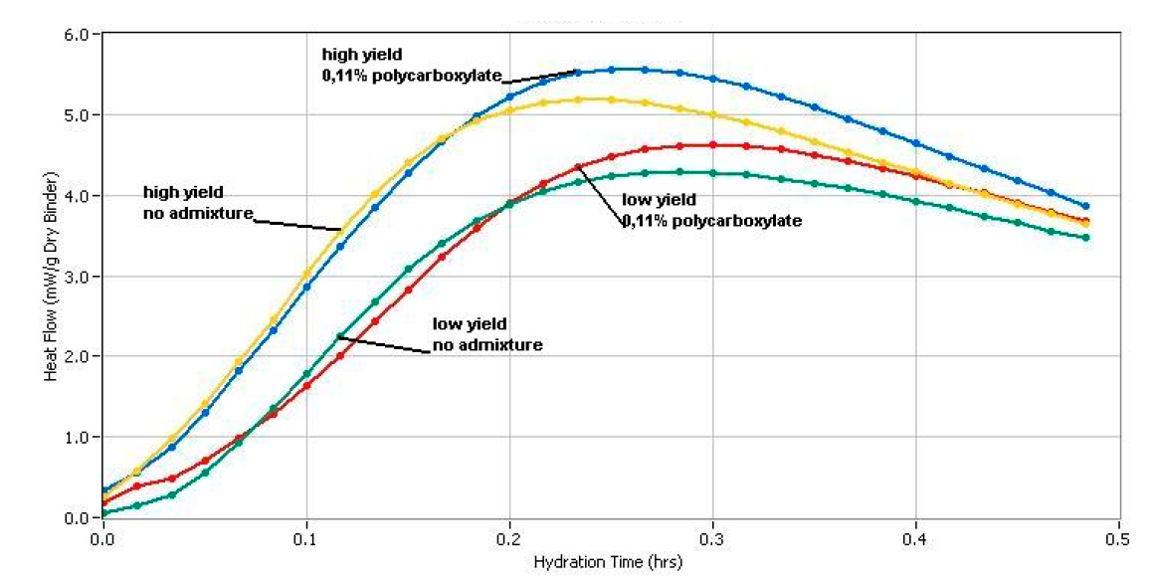
Yield stress vs. heat development/reactivity clinker
Kubens, Wallevik, 2010

Slide 36
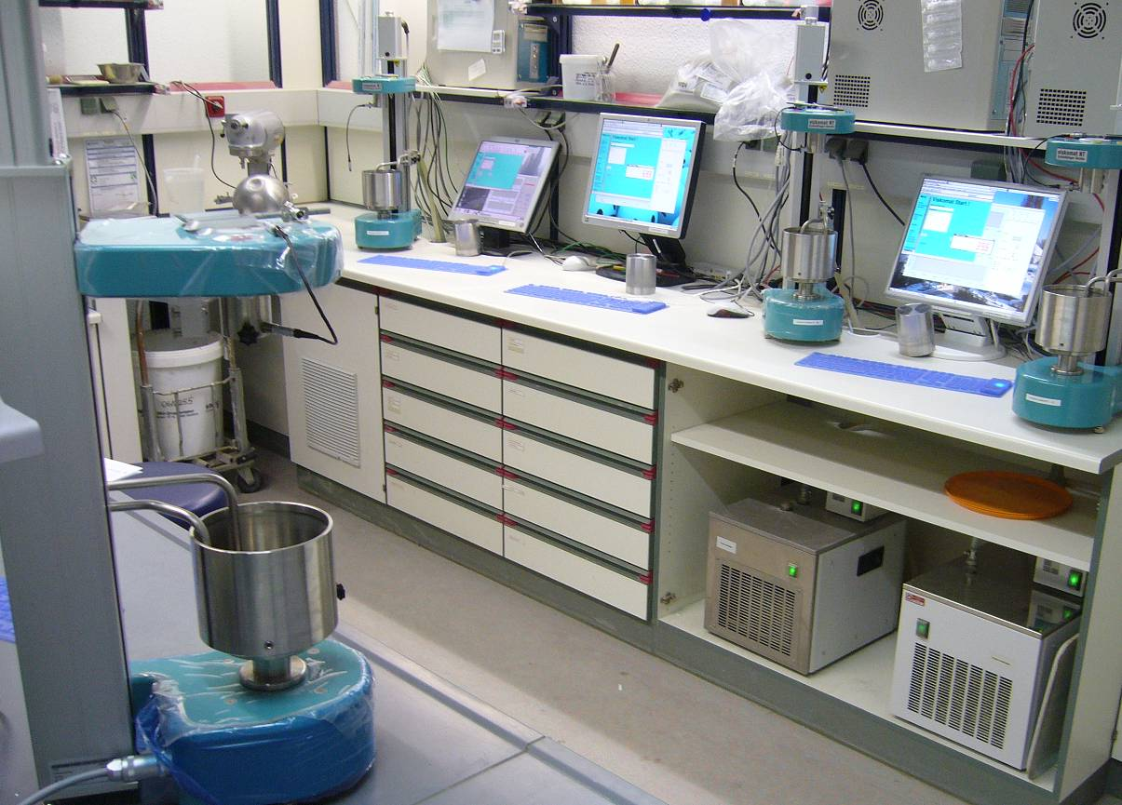
Rheology laboratory Dyckerhoff
Approx. 3500 measurements per year:
-Quality control of all cement types
-Effect of additives
-Answering to customer complaints
-R & D
Cements with optimised workability and high uniformity

Slide 37
Content
Sustainability – Modern trends or duty of enterprise strategy?
Cement production and CO₂ emission – CEM II and CEM III become standard
M-cements – optimised for performance, durable and uniform
Rheology of cement paste vs. cement standard parameters
Rheology of cement paste – Experience from 5 years RheoZ
Summary

Slide 38
RheoZ – Precision and accuracy
Paste made with CEM I 52,5R (four cement mixes, four viscometers)

Slide 39
RheoZ – Reference cement

Slide 40
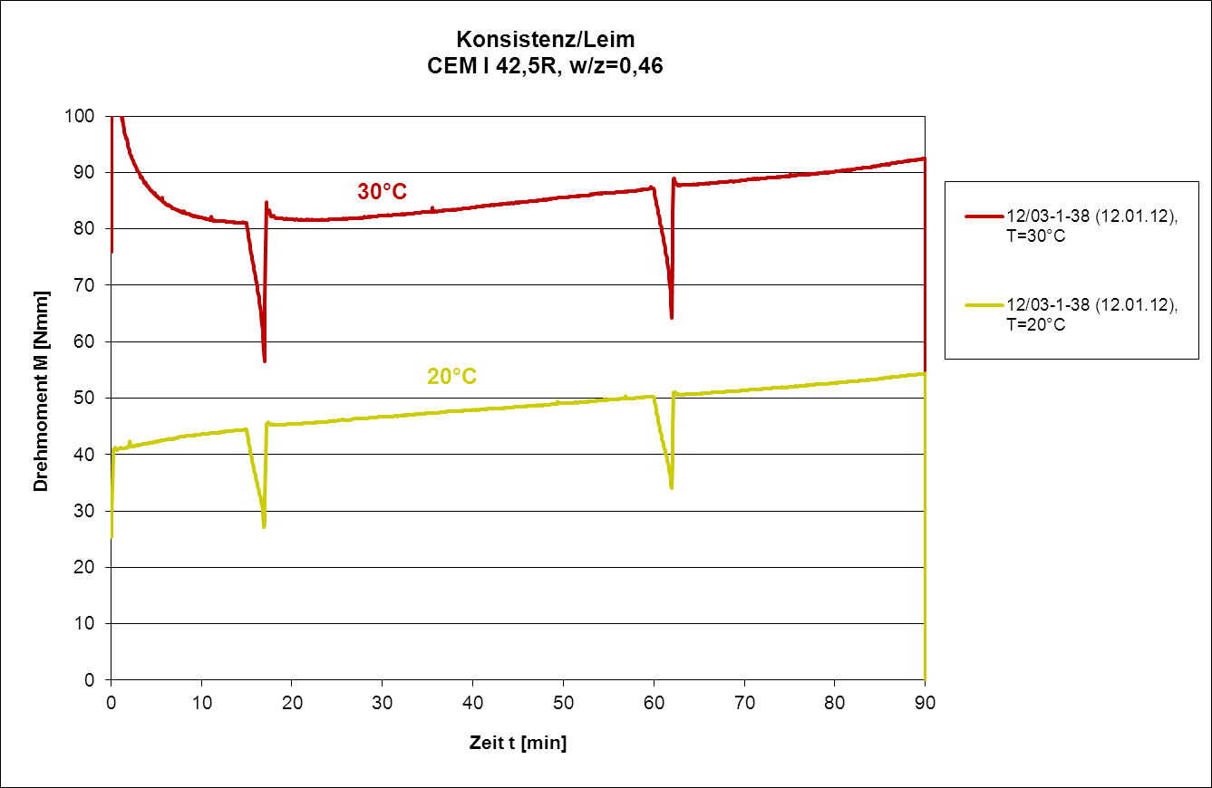
RheoZ – Sensitivity temperature

Slide 41
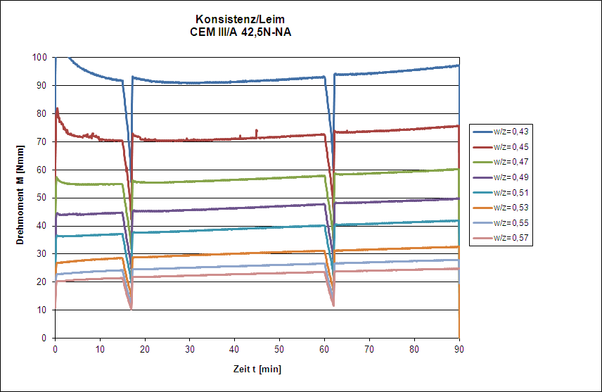
RheoZ – Sensitivity w/c-ratio

Slide 42
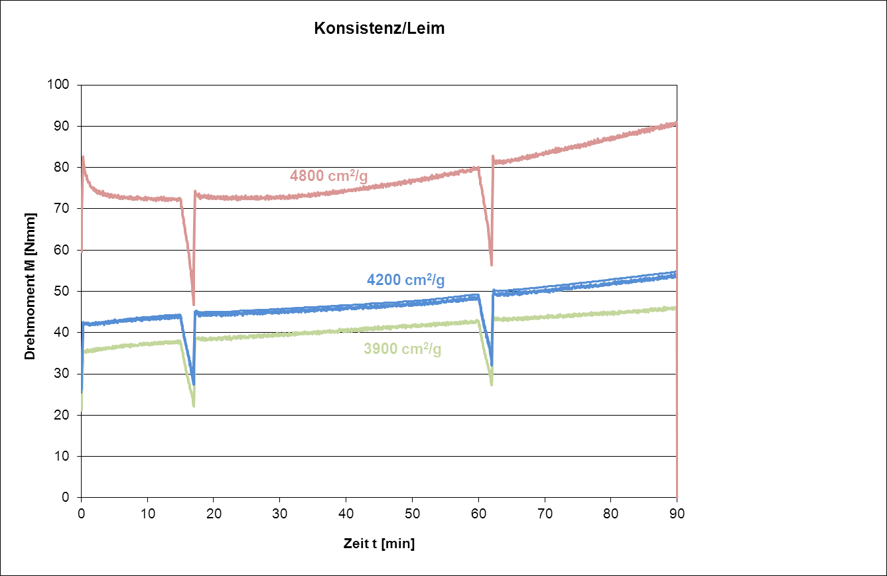
RheoZ – Sensitivity technology (fineness)

Slide 43
RheoZ – Sensitivity technology (fineness)

Slide 44
RheoZ – Sensitivity technology
(common/separate milling CEM III/B 42,5 N)

Slide 45
RheoZ - CEM III/B over a period of 2 years

Slide 46
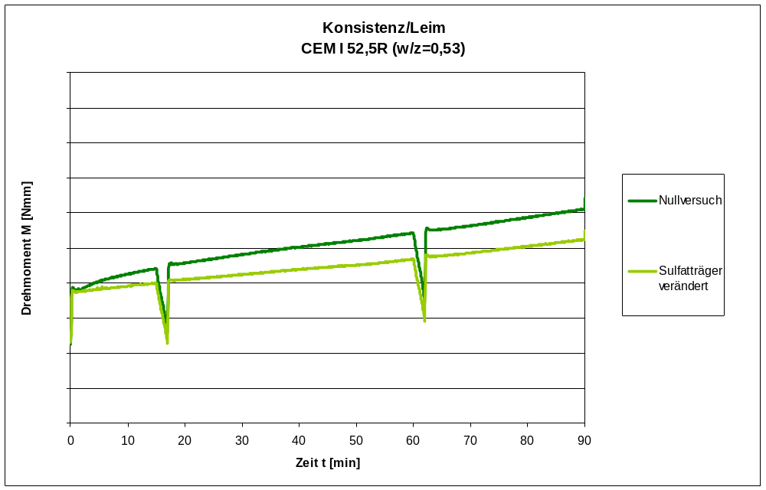
RheoZ – Sensitivity technology (gypsum phases)

Slide 47
RheoZ – Sensitivity technology
Start-up cement cooler

Slide 48
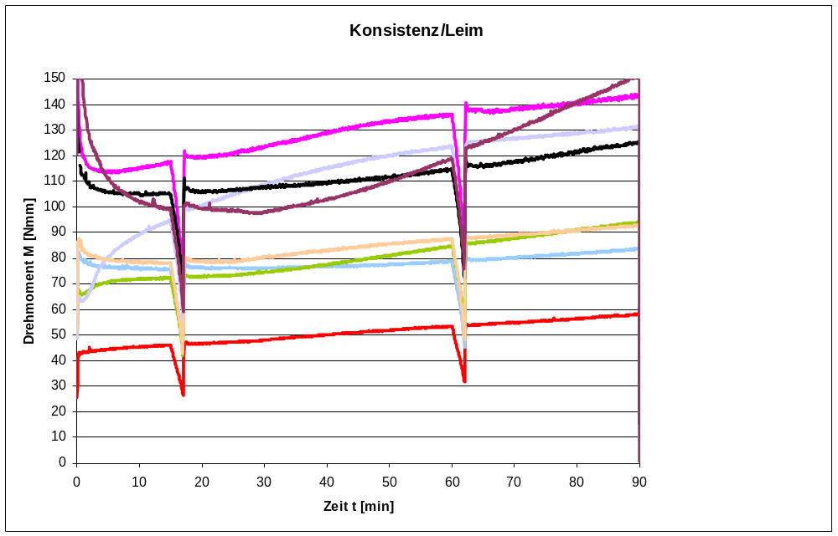
Comparison CEM I 52,5 R – w/c rate constant 0,485

Slide 49
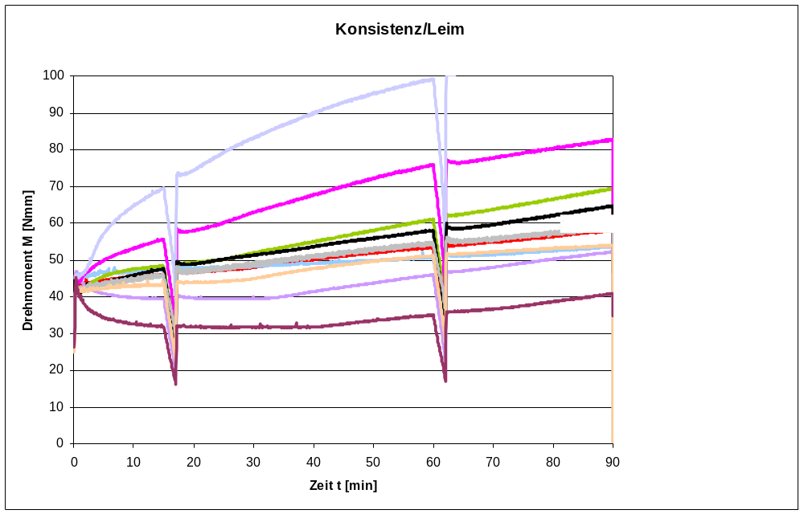
Comparison CEM I 52,5 R – Consistence at beginning constant

Slide 50
Content
Sustainability – Modern trends or duty of enterprise strategy?
Cement production and CO₂ emission – CEM II and CEM III become standard
M-cements – optimised for performance, durable and uniform
Rheology of cement paste vs. cement standard parameters
Rheology of cement paste – Experience from 5 years RheoZ
Summary

Slide 51
Summary
Sustainability = no modern trend, but duty of the enterprise strategy
CEM II and CEM III are the standard cements, CEM X will emerge
Dyckerhoff uses for composite cements S, LL, V and P
Seperate milling enables high performance, durability and uniformity of multi-component cements
M-cements combine the positive properties of clinker and composites
Part of the product strategy is the high uniformity (assessed with new measurement techniques for the optimisation of workability)
Five years Dyckerhoff RheoZ => Cements with high optimised uniformity regarding workability
Aim: To bridge the gap between cement rheology and rheology of mortar and concrete

Slide 52

Thank you for your attention!
Heraklit - panta rhei – everything flows, even the mountains, you have to wait long enough

